Slide 1
Vaccinated susceptibles are able to get infected
Parameter | Description
r_{x} | Rate of Vaccination in subpopulation x
β_{xy} | Per capita rate of transmission from infectious subpopulation y to susceptible subpopulation x
γ | Per capita rate of recovery
σ₁ | Per capita rate of immunity loss (vaccinated individuals)
σ₂ | Per capita rate of immunity loss (from natural infection)
σ₃ | Per capita rate of immunity loss (for those who have been infected/recovered and vaccinated)
e_{ff1} | Vaccine Efficacy (preventing infection)
e_{ff2} | Vaccine Efficacy (preventing onwards infectiousness)
V_{i}
β_{xx}
Vi_{i}
γ
Vr_{i}
σ₃
σ₁
r_{i} · (S_{i} /(S_{i}+I_{i}+R_{i}))
β_{xx}
S_{i}
I_{i}
γ
R_{i}
Example sub-population i
σ₂
r_{i} · (I_{i}/(S_{i}+I_{i}+R_{i}))
Compartment | Description (Proportion of population in…)
S_{x} | Susceptibles in subpopulation x
I_{x} | Infectious individuals in subpopulation x
R_{x} | Recovered individuals in subpopulation x
Rv_{x} | Recovered or Infectious and subsequently vaccinated in subpopulation x
V_{x} | Vaccinated individuals in subpopulation x
Vi_{x} | Vaccinated and infectious individuals in subpopulation x
Vr_{x} | Vaccinated and recovered individuals in subpopulation x
Rv_{i}
σ₃
r_{i} · (R_{i}/(S_{i}+I_{i}+R_{i}))
Example Transmission Route – Infection from subpop j to i
To/From
Susceptible (S_{i})
Vaccinated (V_{i})
β_{ij}I_{j}S_{i}
(1-e_{ff1})β_{ij}I_{j}V_{i}
Infected (I_{j})
S_{i}
I_{i}
V_{i}
Vi_{i}
Vaccination Rate (r_{i})
We model the vaccination rate as a function of the:
Total fraction of individuals in S, I and R compartments (available to vaccinated) at the start of the vaccination period multiplied by the proportion divided by the duration of the vaccination period for the specific subgroup.
We assume that the rate of vaccination is constant (r_{i}*1), therefore the rate of vaccination in S, I and R compartments must be normalised to the total proportion of individuals in these three compartments.
Vaccinated but
Infected (Vi_{j})
(1-e_{ff2})β_{ij}Vi_{j}S_{i}
(1-e_{ff1})(1-e_{ff2})β_{ij}Vi_{j}V_{i}
S_{i}
I_{i}
V_{i}
Vi_{i}

Slide 2
Example equations sub-population i
$$\frac{dS_{i}}{dt}=σ1V_{i}+{σ2R}_{i}+σ3{(Rv}_{i}+{Vr}_{i}){−β}_{ii}S_{i}I_{i}−β_{ij}S_{i}I_{j}−β_{ik}S_{i}I_{k}−{\left(1−e_{ff2}\right)β}_{ii}S_{i}{Vi}_{i}−\left(1−e_{ff2}\right)β_{ij}S_{i}{Vi}_{j}−\left(1−e_{ff2}\right)β_{ik}S_{i}{Vi}_{k}−r_{i}\frac{S_{i}}{S_{i}+I_{i}\text{+ }R_{i} }$$
$$\frac{dI_{i}}{dt}=β_{ii}S_{i}I_{i}+β_{ij}S_{i}I_{j}+β_{ik}S_{i}I_{k}+{\left(1−e_{ff2}\right)β}_{ii}S_{i}{Vi}_{i}+\left(1−e_{ff2}\right)β_{ij}S_{i}{Vi}_{j}+\left(1−e_{ff2}\right)β_{ik}S_{i}{Vi}_{k}−γI_{i}−r_{i}\frac{I_{i}}{S_{i}+I_{i}\text{+ }R_{i} }$$
$$\frac{dR_{i}}{dt}=γI_{i}−r_{i}\frac{R_{i}}{S_{i}+I_{i}\text{+ }R_{i} }−σ_{2}R_{i}$$
$$\frac{d{Rv}_{i}}{dt}=r_{i}\frac{I_{i}+R_{i}}{S_{i}+I_{i}\text{+ }R_{i} }−σ_{3}{Rv}_{i}$$
$$\frac{dV_{i}}{dt}=r_{i}\frac{S_{i}}{S_{i}+I_{i}\text{+ }R_{i} }−{\left(1−e_{ff1}\right)β}_{ii}V_{i}I_{i}−{\left(1−e_{ff1}\right)β}_{ij}V_{i}I_{j}−{\left(1−e_{ff1}\right)β}_{ik}V_{i}I_{k}−\left(1−e_{ff1}\right) {\left(1−e_{ff2}\right)β}_{ii}V_{i}{Vi}_{i}−\left(1−e_{ff1}\right)\left(1−e_{ff2}\right)β_{ij}V_{i}{Vi}_{j}−\left(1−e_{ff1}\right)\left(1−e_{ff2}\right)β_{ik}V_{i}{Vi}_{k}−σ_{1}V_{i}$$
$$\frac{d{Vi}_{i}}{dt}={\left(1−e_{ff1}\right)β}_{ii}V_{i}I_{i}+{\left(1−e_{ff1}\right)β}_{ij}V_{i}I_{j}+{\left(1−e_{ff1}\right)β}_{ik}V_{i}I_{k}+\left(1−e_{ff1}\right) {\left(1−e_{ff2}\right)β}_{ii}V_{i}{Vi}_{i}+\left(1−e_{ff1}\right)\left(1−e_{ff2}\right)β_{ij}V_{i}{Vi}_{j}+\left(1−e_{ff1}\right)\left(1−e_{ff2}\right)β_{ik}V_{i}{Vi}_{k}−γ{Vi}_{i}$$
$$\frac{d{Vr}_{i}}{dt}=γ{Vi}_{i}−σ_{3}{Vr}_{i}$$
Parameter | Description
r_{x} | Rate of Vaccination in subpopulation x
β_{xy} | Per capita rate of transmission from infectious subpopulation y to susceptible subpopulation x
γ | Per capita rate of recovery
σ₁ | Per capita rate of immunity loss (vaccinated individuals)
σ₂ | Per capita rate of immunity loss (from natural infection)
σ₃ | Per capita rate of immunity loss (for those who have been infected/recovered and vaccinated)
e_{ff1} | Vaccine Efficacy (preventing infection)
e_{ff2} | Vaccine Efficacy (preventing onwards infectiousness)
Compartment | Description (Proportion of population in…)
S_{x} | Susceptibles in subpopulation x
I_{x} | Infectious individuals in subpopulation x
R_{x} | Recovered individuals in subpopulation x
Rv_{x} | Recovered or Infectious and subsequently vaccinated in subpopulation x
V_{x} | Vaccinated individuals in subpopulation x
Vi_{x} | Vaccinated and infectious individuals in subpopulation x
Vr_{x} | Vaccinated and recovered individuals in subpopulation x

Slide 3
Model Details
We assume that 0.79% of the Scottish population is currently infected and 7.3% have already been infected and are now “Recovered”. Each subpopulation is proportionately the same size.
Vaccine efficacy is modelled at 90% (both e_{ff1} and e_{ff2}) and coverage (P_{i}, P_{j} and P_{k}) aims for 90% of the entire subpopulation.
We currently assume a indefinite period of immunity (rate of immunity loss σ₁, σ₂ and σ₃ = 0).
We explore 4 different scenarios:
Baseline
We model sequential vaccination of 3 sub-populations. Each vaccination schedule lasts 90 days and aims for 90% coverage of the available susceptibles, infecteds and recovereds in the vaccinated subpopulation at the beginning of the simulation.
After vaccination of each subpopulation, the sub-population is released from NPIs, with the R increasing from 1.4 to 4.2.
Full Release
We explore 3 different release scenarios:
First Group
We model a full release of the entire population (i, j and k) after the vaccination of the first sub-population (i) (after 90 days). This increases the R of the entire population from 1.4 to 4.2.
Middle Group
We model a full release of the entire population (i, j and k) after the vaccination of the second sub-population (j) (after 180 days). This increases the R of the entire population from 1.4 to 4.2.
Last Group
We model a full release of the entire population (i, j and k) after the vaccination of the final sub-population (k) (after 270 days). This increases the R of the entire population from 1.4 to 4.2.
Initial Conditions
S_{i} = 0.3064
S_{j} = 0.3064
S_{k} = 0.3064
I_{i} = 0.0071/3
I_{j} = 0.0071/3
I_{k} = 0.0071/3
V_{i} = 0
V_{j} = 0
V_{k} = 0
R_{i} = 0.073/3
R_{j} = 0.073/3
R_{k} = 0.073/3
Subpopulation i
Target Coverage = 90%
Duration = 90 days
Trigger Date = day 0
Subpopulation j
Target Coverage = 90%
Duration = 90 days
Trigger Date = day 90
Subpopulation k
Target Coverage = 90%
Duration = 90 days
Trigger Date = day 180

Slide 4
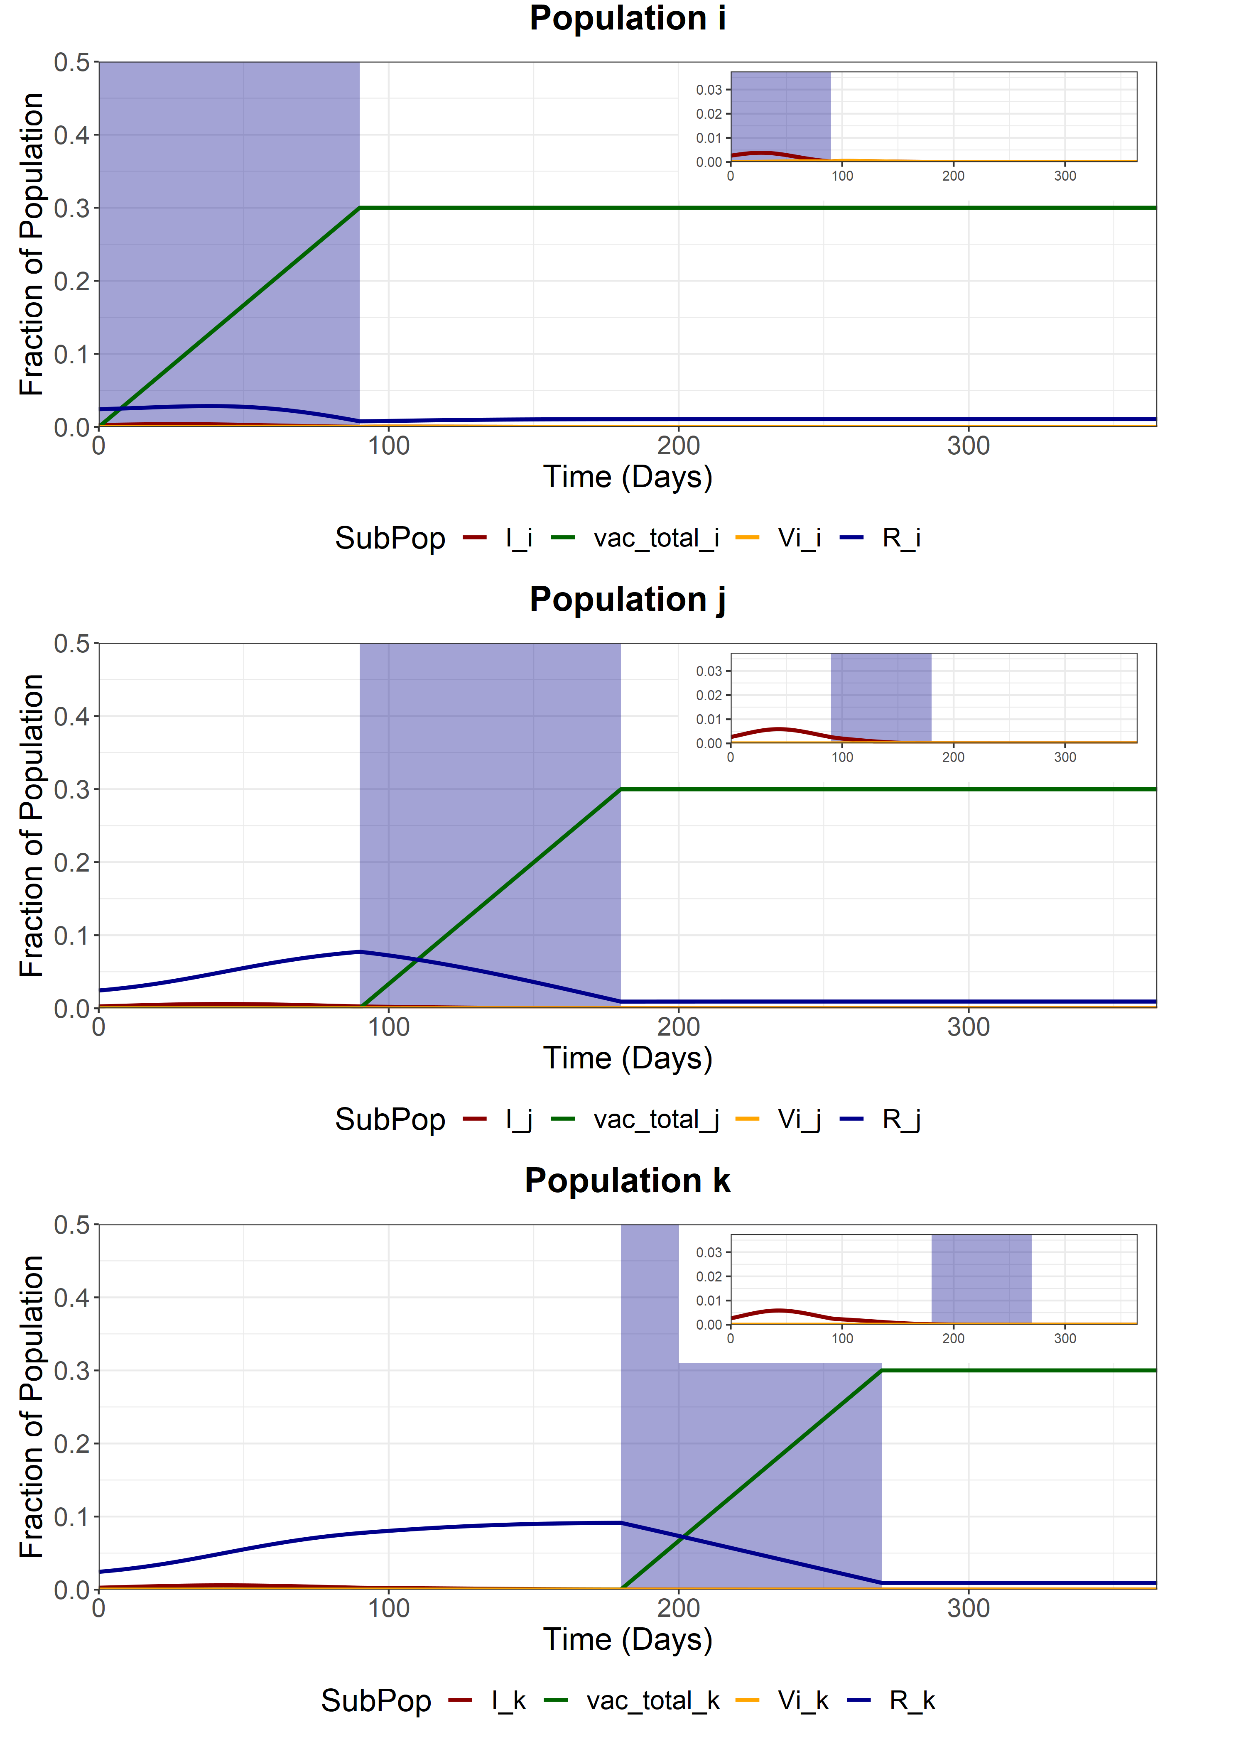
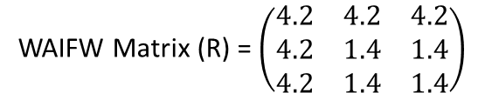
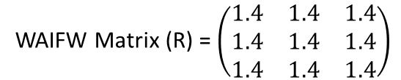
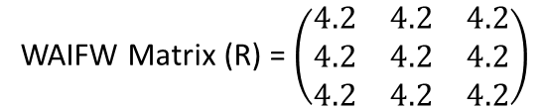
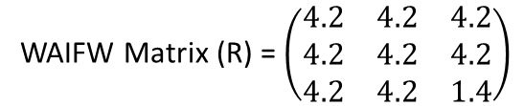
Baseline
We model sequential vaccination of 3 sub-populations. Each vaccination schedule lasts 90 days and aims for 90% coverage of the available susceptibles, infecteds and recovereds at the beginning of the simulation. After vaccination of each subpopulation, the sub-population is released from NPIs, with the R increasing from 1.4 to 4.2.
Note that at the end of the vaccination period, we do not see exactly 90% of each sub-population vaccinated. This is due to the effects of waning immunity and infection (and subsequent loss of immunity) during the vaccination period (90% of each subpop is ~0.3).
WAIFW Matrix (R) = $\left(\begin{matrix}1.4 & 1.4 & 1.4 \\ 1.4 & 1.4 & 1.4 \\ 1.4 & 1.4 & 1.4\end{matrix}\right)$
During the pop i vaccination (t = 0-90)
WAIFW Matrix (R) = $\left(\begin{matrix}4.2 & 4.2 & 4.2 \\ 4.2 & 1.4 & 1.4 \\ 4.2 & 1.4 & 1.4\end{matrix}\right)$
During the pop j vaccination (t = 90-180)
WAIFW Matrix (R) = $\left(\begin{matrix}4.2 & 4.2 & 4.2 \\ 4.2 & 4.2 & 4.2 \\ 4.2 & 4.2 & 1.4\end{matrix}\right)$
During the pop k vaccination (t = 180-270)
WAIFW Matrix (R) = $\left(\begin{matrix}4.2 & 4.2 & 4.2 \\ 4.2 & 4.2 & 4.2 \\ 4.2 & 4.2 & 4.2\end{matrix}\right)$
After final vaccination schedule (t = 270)

Slide 5
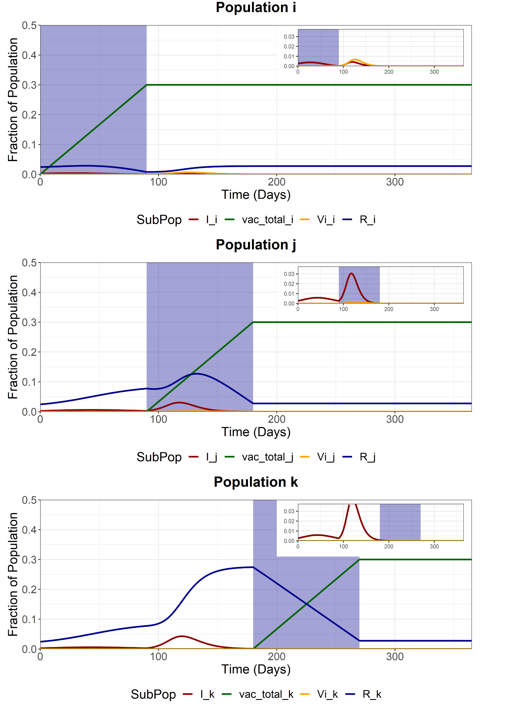
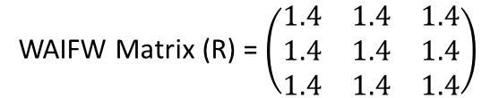
Full Release - First Group (i)
We model a full release of the entire population (i, j and k) after the vaccination of the first sub-population (i). This increases the R of the entire population from 1.4 to 4.2.
Note that at the end of the vaccination period, we do not see exactly 90% of the population vaccinated. This is due to the effects of waning immunity and infection (and subsequent loss of immunity) during the vaccination period (90% of each subpop is ~0.3).
WAIFW Matrix (R) = $\left(\begin{matrix}1.4 & 1.4 & 1.4 \\ 1.4 & 1.4 & 1.4 \\ 1.4 & 1.4 & 1.4\end{matrix}\right)$
Before first vaccination schedule (t < 90)
WAIFW Matrix (R) = $\left(\begin{matrix}4.2 & 4.2 & 4.2 \\ 4.2 & 4.2 & 4.2 \\ 4.2 & 4.2 & 4.2\end{matrix}\right)$
After first vaccination schedule (t > 90)

Slide 6
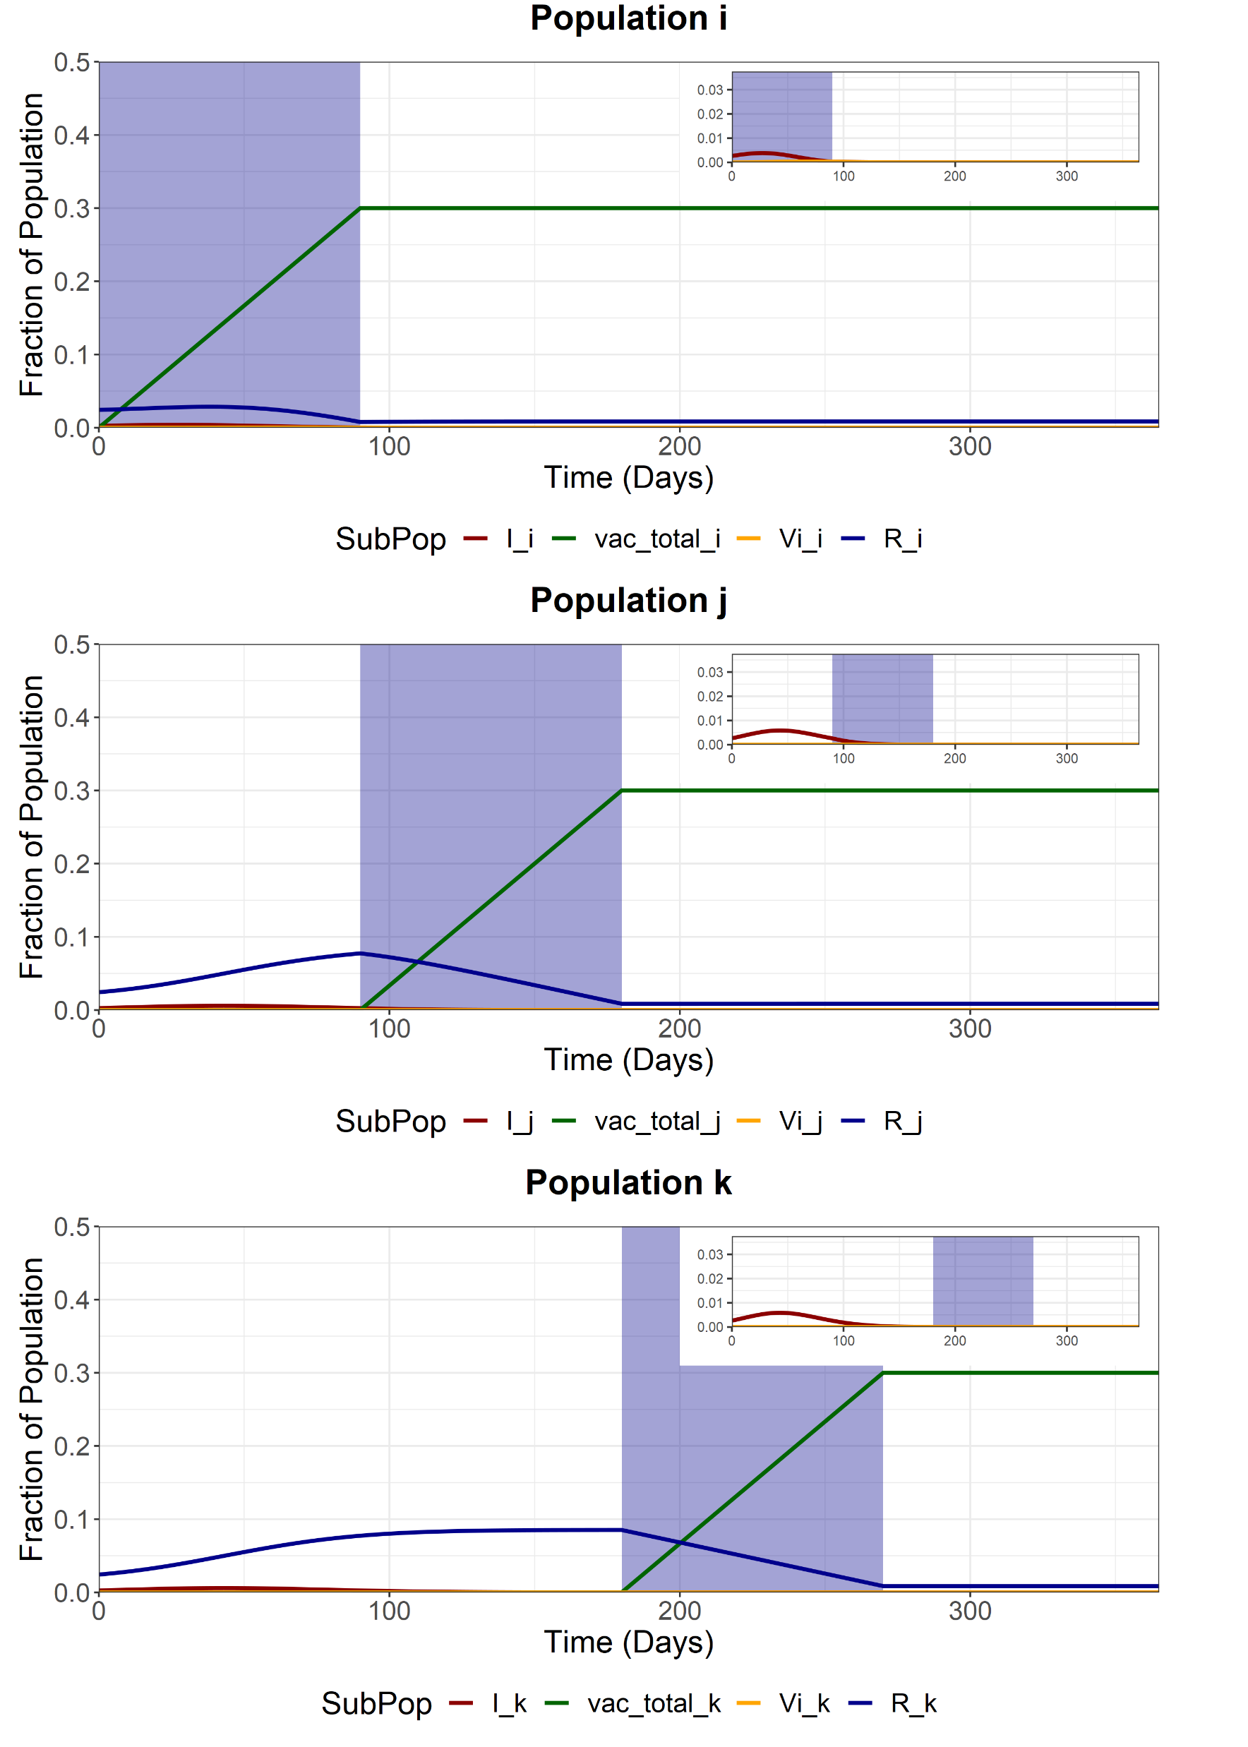
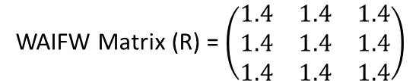
Full Release - Second Group (j)
We model a full release of the entire population (i, j and k) after the vaccination of the second sub-population (j). This increases the R of the entire population from 1.4 to 4.2.
Note that at the end of the vaccination period, we do not see exactly 90% of the population vaccinated. This is due to the effects of waning immunity and infection (and subsequent loss of immunity) during the vaccination period (90% of each subpop is ~0.3).
WAIFW Matrix (R) = $\left(\begin{matrix}1.4 & 1.4 & 1.4 \\ 1.4 & 1.4 & 1.4 \\ 1.4 & 1.4 & 1.4\end{matrix}\right)$
Before second vaccination schedule (t < 180)
WAIFW Matrix (R) = $\left(\begin{matrix}4.2 & 4.2 & 4.2 \\ 4.2 & 4.2 & 4.2 \\ 4.2 & 4.2 & 4.2\end{matrix}\right)$
After second vaccination schedule (t > 180)

Slide 7

Full Release - Second Group (k)
We model a full release of the entire population (i, j and k) after the vaccination of the last sub-population (k). This increases the R of the entire population from 1.4 to 4.2.
Note that at the end of the vaccination period, we do not see exactly 90% of the population vaccinated. This is due to the effects of waning immunity and infection (and subsequent loss of immunity) during the vaccination period (90% of each subpop is ~0.3).
WAIFW Matrix (R) = $\left(\begin{matrix}1.4 & 1.4 & 1.4 \\ 1.4 & 1.4 & 1.4 \\ 1.4 & 1.4 & 1.4\end{matrix}\right)$
Before final vaccination schedule (t < 270)
WAIFW Matrix (R) = $\left(\begin{matrix}4.2 & 4.2 & 4.2 \\ 4.2 & 4.2 & 4.2 \\ 4.2 & 4.2 & 4.2\end{matrix}\right)$
After final vaccination schedule (t > 270)

Slide 8
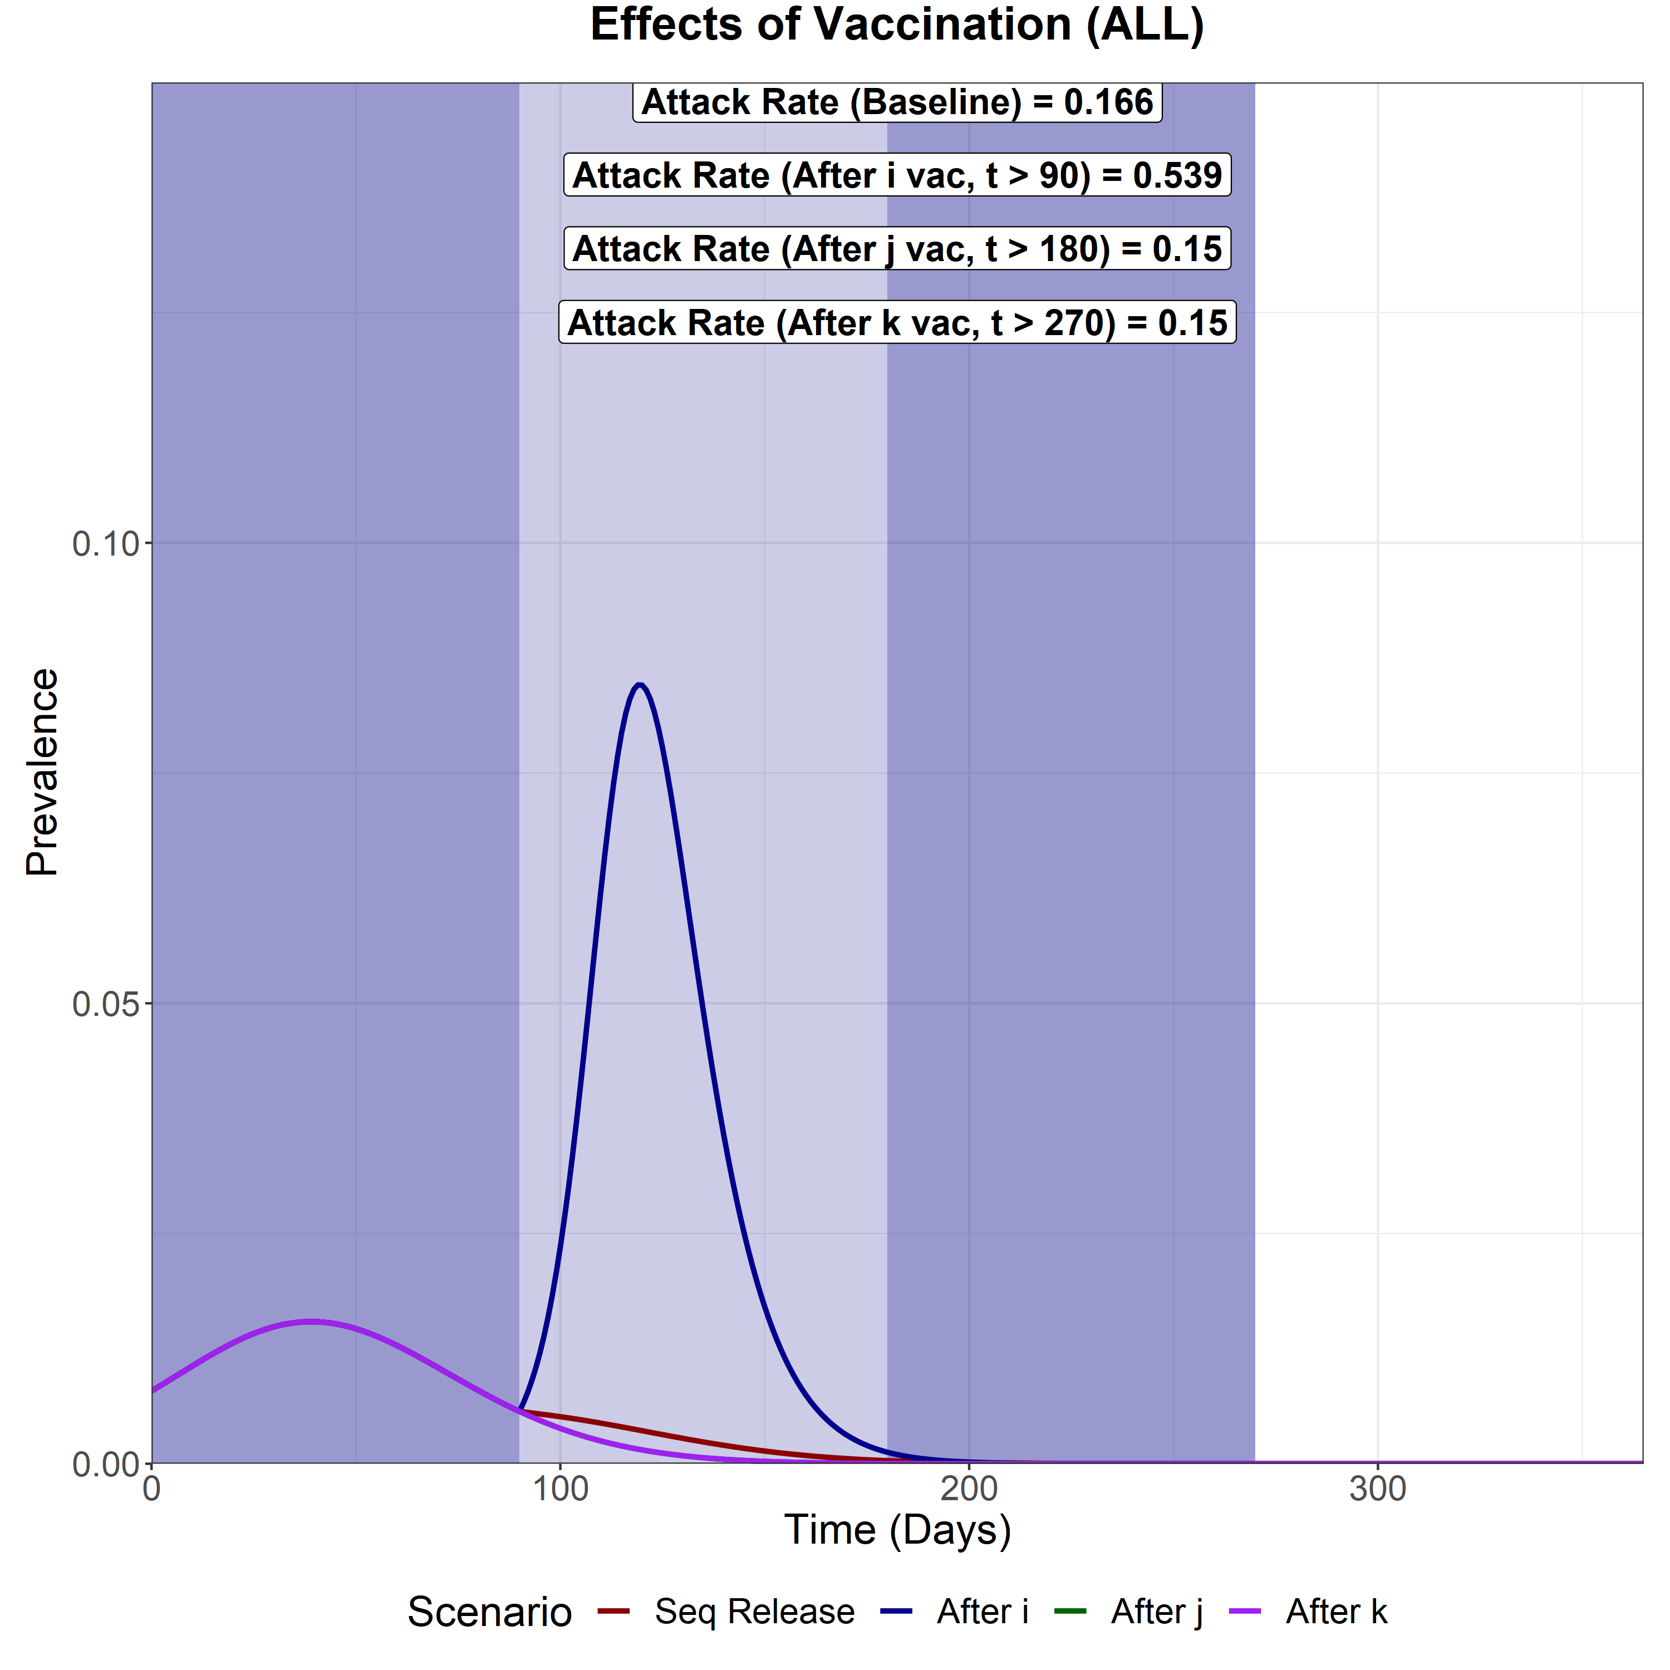
Scenario Analysis (Total Infected)
We now compare the total epidemic curve (the sum of the infectious compartment in each subpopulation) for 4 different scenarios:
With vaccination and sequential intervention release
Full release after vaccination of the first subpopulation (i)
Full release after vaccination of the second subpopulation (j)
Full release after vaccination of the last subpopulation (k)
The three shaded areas are the vaccination periods for subpopulation i, j and k respectively.
If we assume a baseline NPI R = 1.1, then all scenarios other than the earliest NPI release (release of pop i) will cause elimination.
The second worst is the sequential elimination strategy.
Full releases for the 180+ and 270+ day strategies have equal efficacy.

